Slide 1
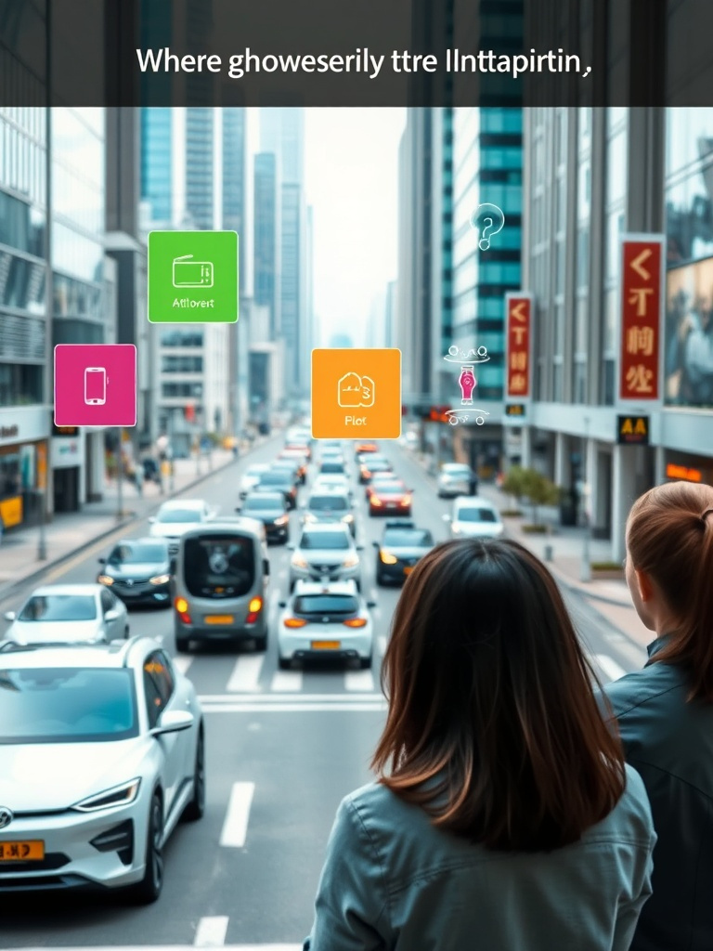
AI in Urban Mobility
Lifeline AI
NAME: TVTT
(Ishan Silwal, Sandip Bhusal, Animesh Maharjan)
DATE: SEP 5, 2025
1

Slide 2
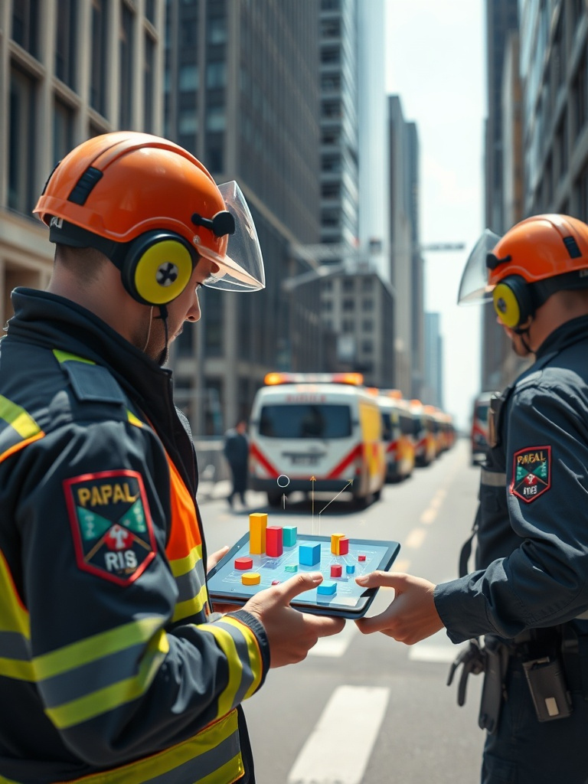
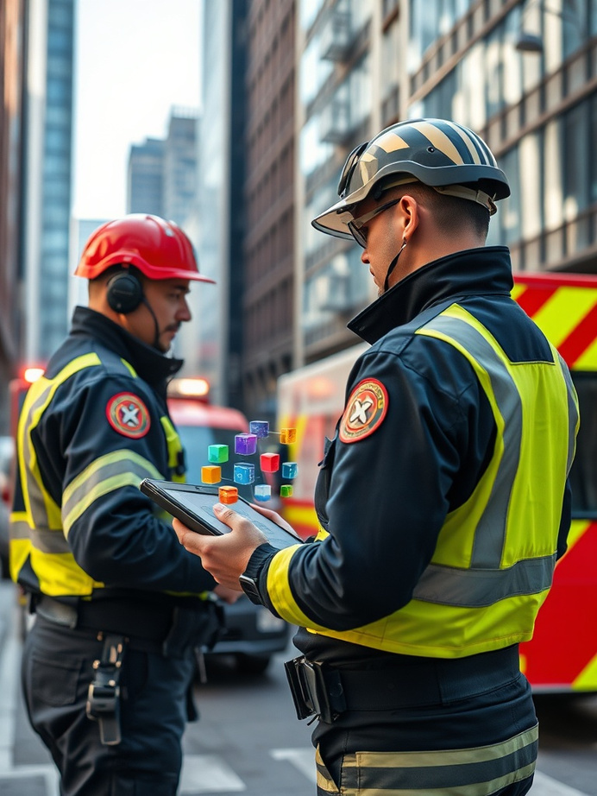

Problem
AI in Urban Mobility
Emergency delays cost lives
Survival falls by 6% per minute in cardiac arrest. Urban congestion worsens response times.
2

Slide 3

AI in Urban Mobility
Global Impact
Worldwide deaths
~60 million deaths/year worldwide among which 60 thousand deaths are caused due to ambulance delay which is 5–10 deaths per hour linked to ambulance delays. Traffic congestion is a global barrier to EMS.
3

Slide 4

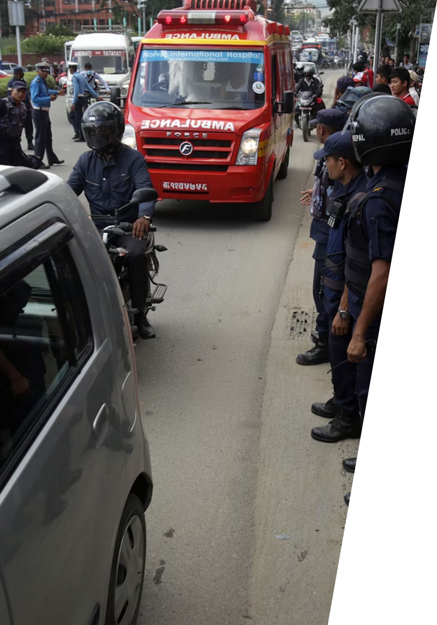
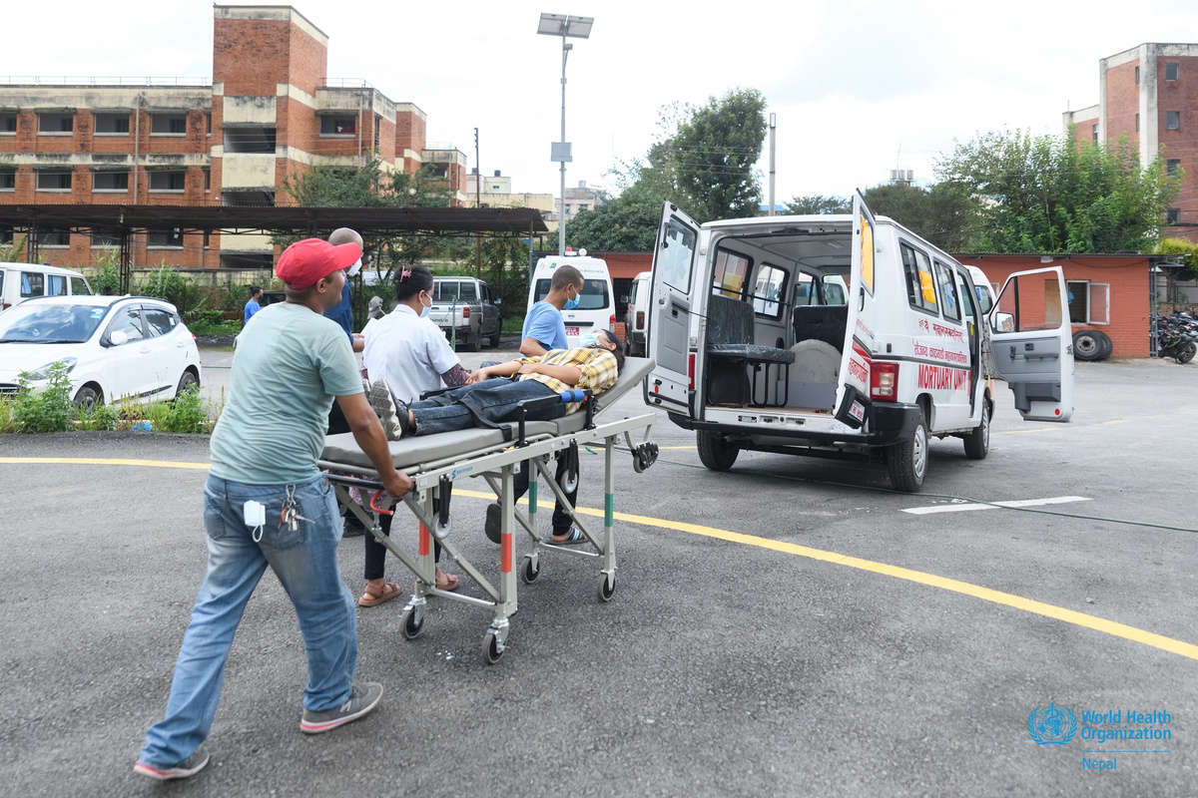
Nepal Context
AI in Urban Mobility
Ambulance usage
Ambulance use <10% of emergency room arrivals. Many patients use taxis(53.6%) and private vehicles(11.4%). Est. 1 death every 30–40 hours from delayed Emergency Medical Service. Limited pre-hospital care facilities.
4

Slide 5

AI in Urban Mobility
Proposed Solution
AI-Driven Emergency Routing System
Real-time traffic + GPS + IoT integration. Dynamic route optimization. Priority signals for ambulances.
5

Slide 6
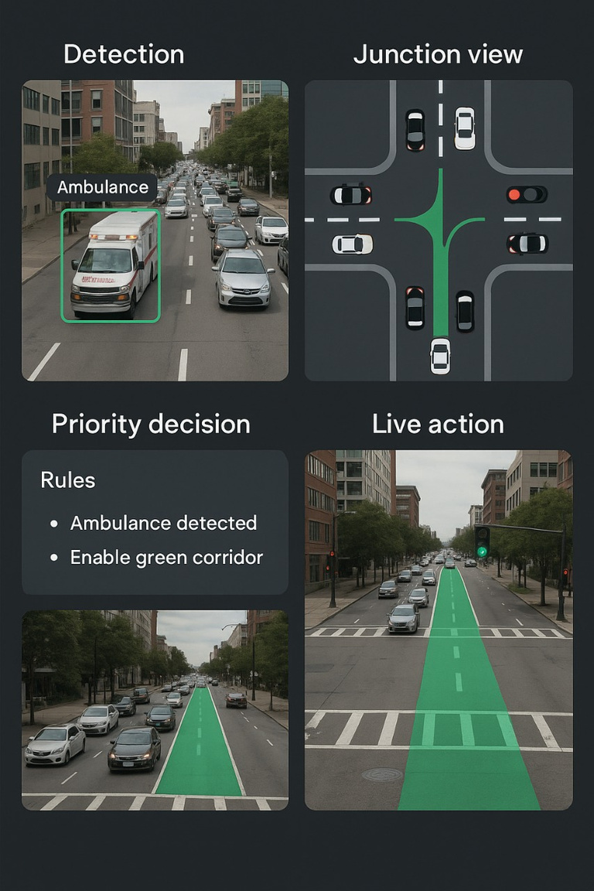
Features
AI in Urban Mobility
Key features of the system
Smart traffic light control. Predictive congestion alerts. Hospital load balancing. Driver guidance via mobile app.
6

Slide 7

How It Works: An Overview
AI in Urban Mobility
The system operates in a seamless, automated sequence:
Detection
Signal Override
Green Corridor Creation
Resume Normal Flow
7

Slide 8
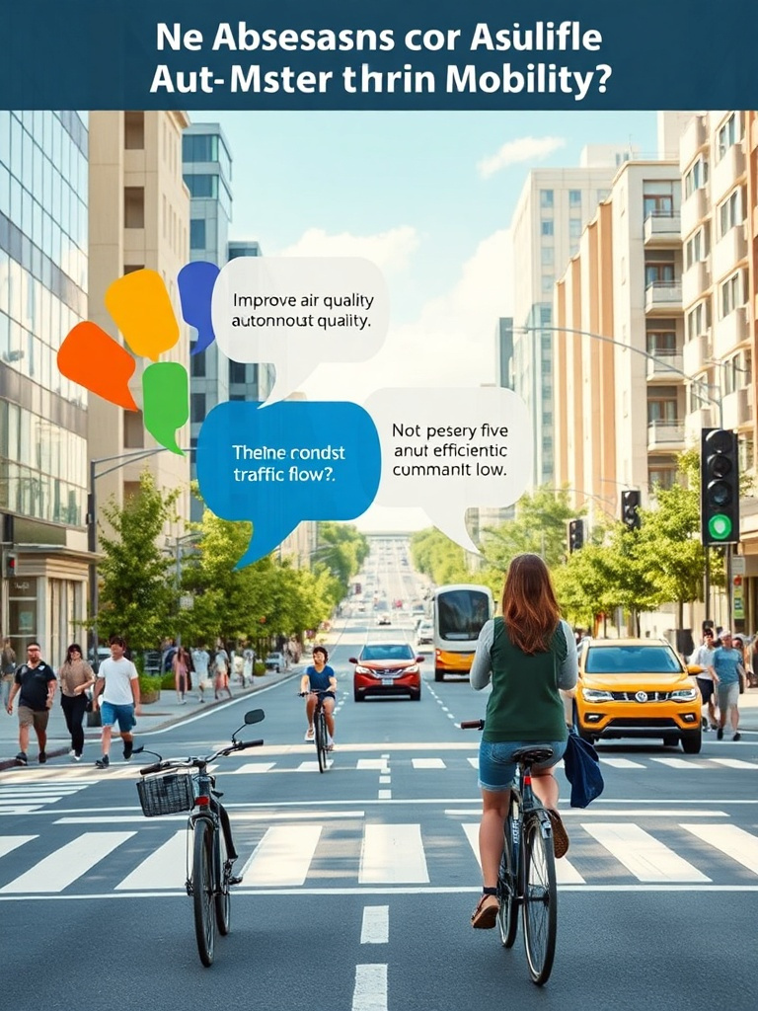
AI in Urban Mobility
Benefits
Advantages of AI in EMS
Faster response times. Reduction in avoidable deaths. Better hospital coordination. Scalable to smart cities.
8

Slide 9
AI in Urban Mobility
LIFELINE AI
Traffic that moves for life

